Slide 1
Continuous-time Controllers
Control Engineering

Slide 2
Course Schedule
Systems
Continuous-time Controllers
Laplace Domain
Poles/Zeros & Stability
Controller Design
Discrete-time Controllers
State Space Representation
Advanced Control Methods

Slide 3
Continuous-time Controllers
Control objectives
PID controllers
Working point
Proportional band

Slide 4
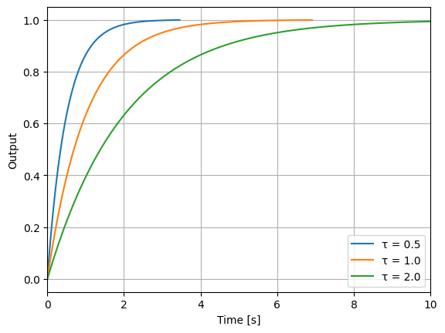
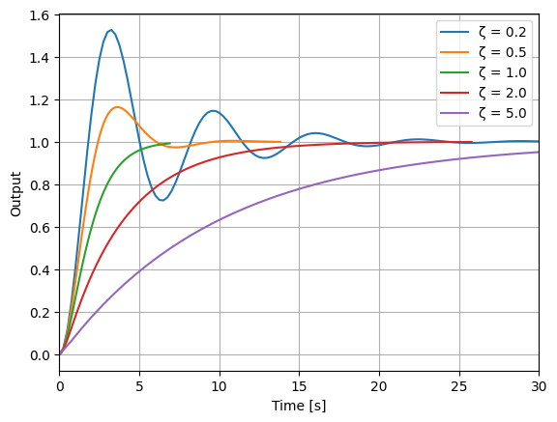
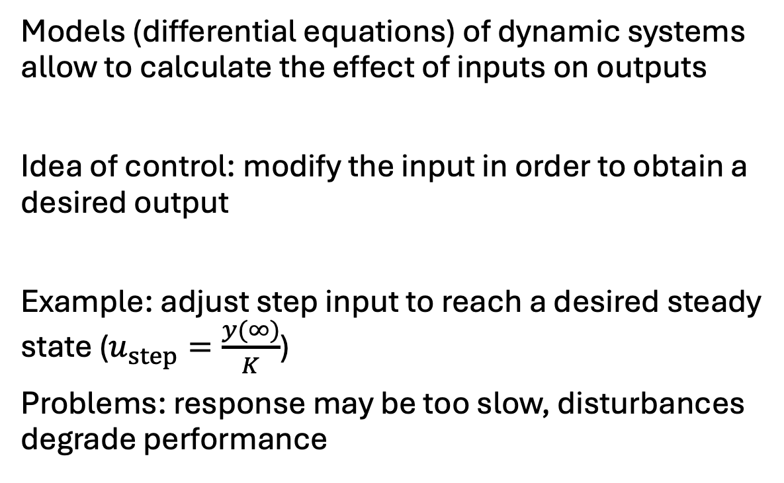
Control
PT1 system
Models (differential equations) of dynamic systems allow to calculate the effect of inputs on outputs
Idea of control: modify the input in order to obtain a desired output
Example: adjust step input to reach a desired steady state ($u_{step}=\frac{y(∞)}{K}$)
Problems: response may be too slow, disturbances degrade performance
Step responses
PT2 system

Slide 5
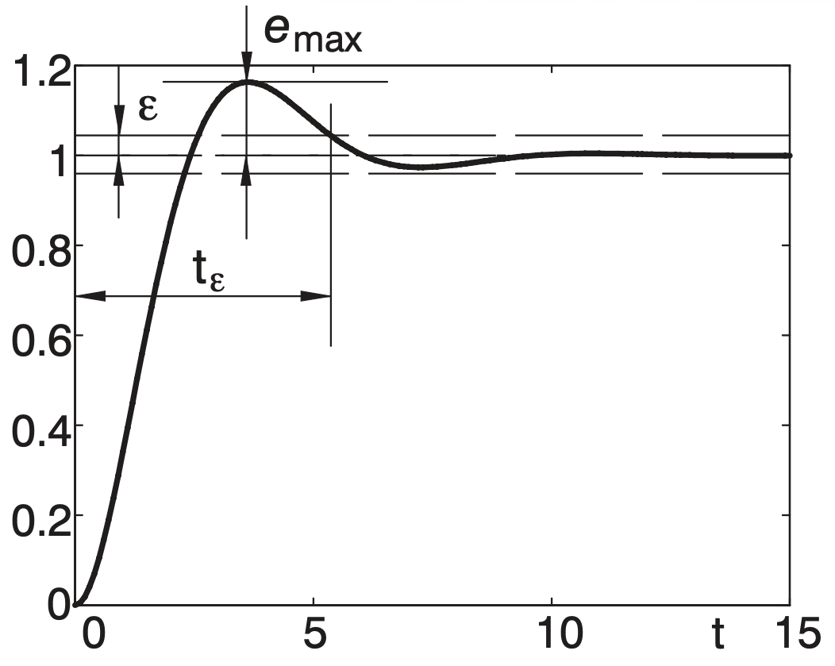
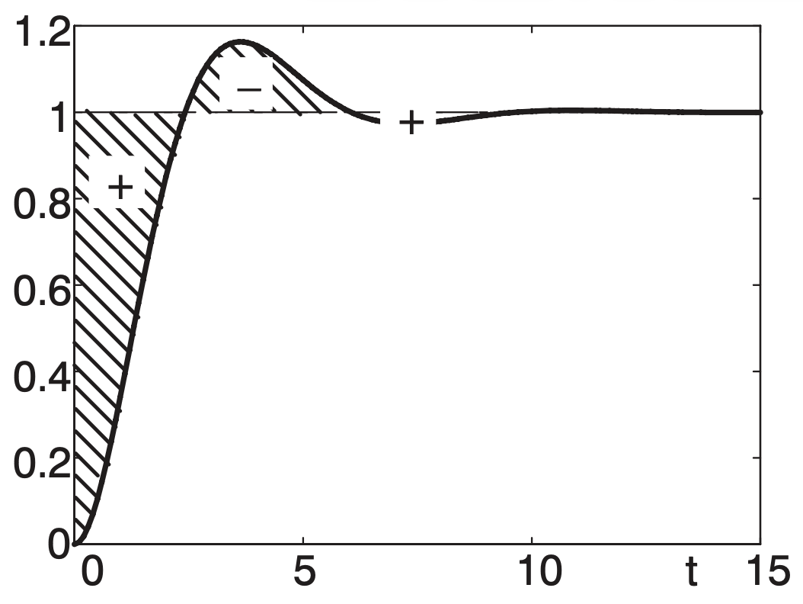
Control Objectives
Stability (bounded output)
Fast response: rise and settling time
Low overshoot
Small steady-state error
Robustness (insensitivity to model uncertainty and disturbances)

Slide 6
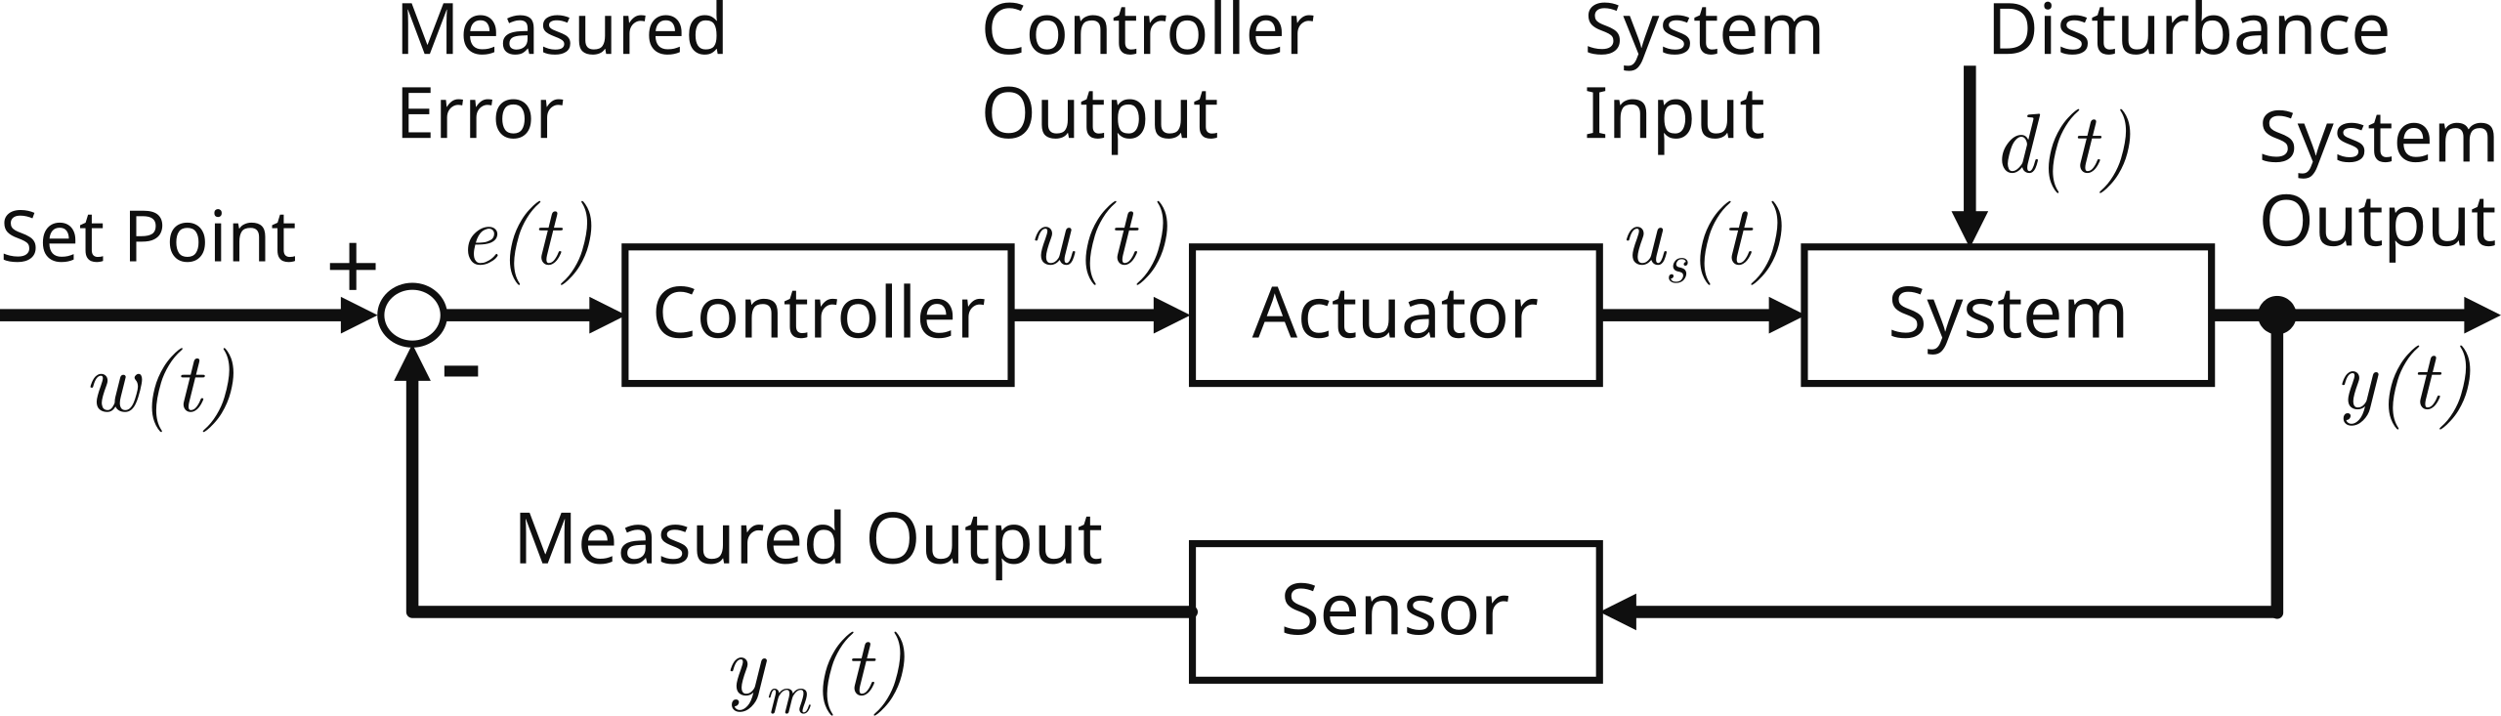
Control Loop
Feedback: measure system output, compare it to desired behavior (e.g., steady state), and use the resulting error as input to a controller
Goal: reduce error

Slide 7
What Is a Controller?
System itself (subsystem of total control system), implemented in hardware or software
Input: measured error
Output: process input (low-energy control signal converted into physical action by actuator)
Hardware controllers
Fast, deterministic, limited flexibility
Examples: mechanical, analog electronic controllers using op-amps, FPGA-based (digital)
Software controllers (use of analog actuators via a digital-to-analog converter)
Flexible, complex algorithms, sampling delays (dead time)
Examples: Microcontroller-based, PLCs

Slide 8
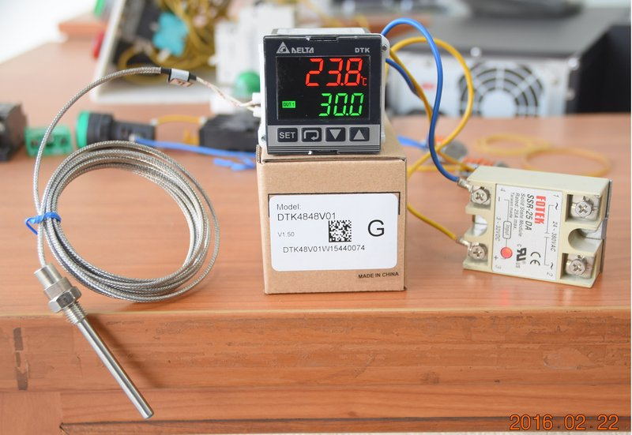
Example: Temperature Control
Sensor:
resistance thermometer to measure temperature (system output)
Actuator:
solid-state relay to switch a heater/cooler (plant) on or off
Controller:
digital electronic PID switching controller to activate the relay (controller output)

Slide 9
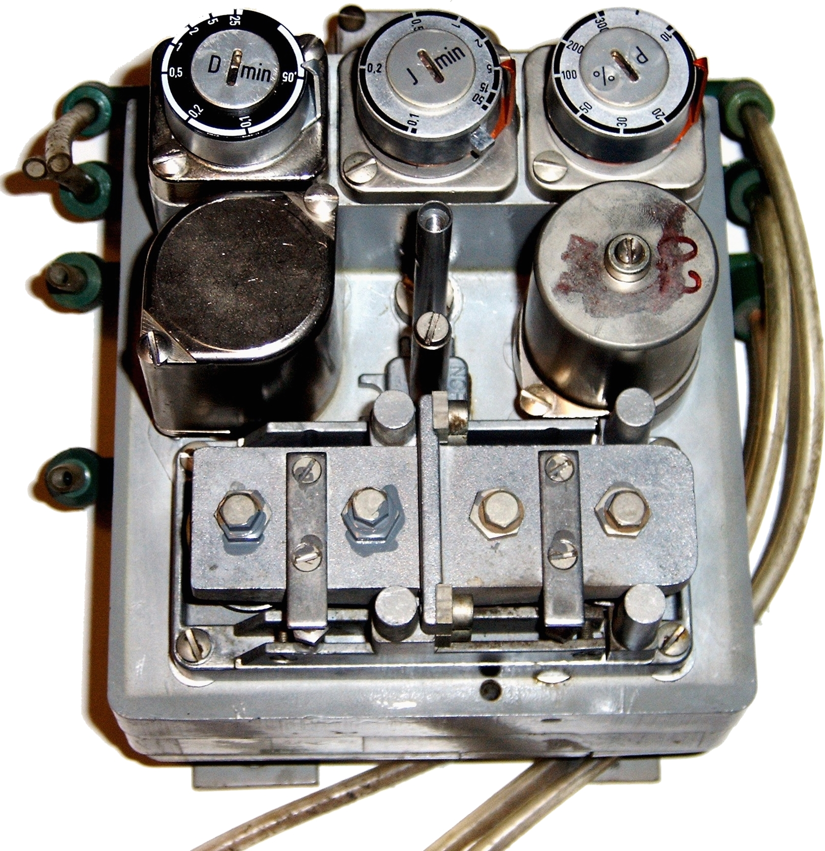
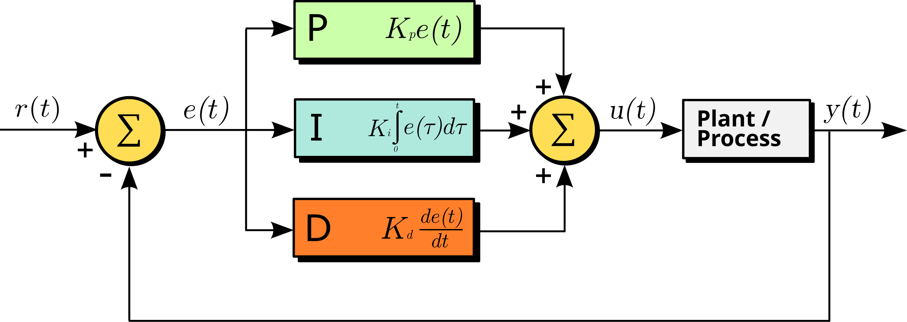
PID Controllers
Example: pneumatic PID
Most widely used industrial controller
P
PI: P + I
PD: P + D
PID: P + I + D

Slide 10
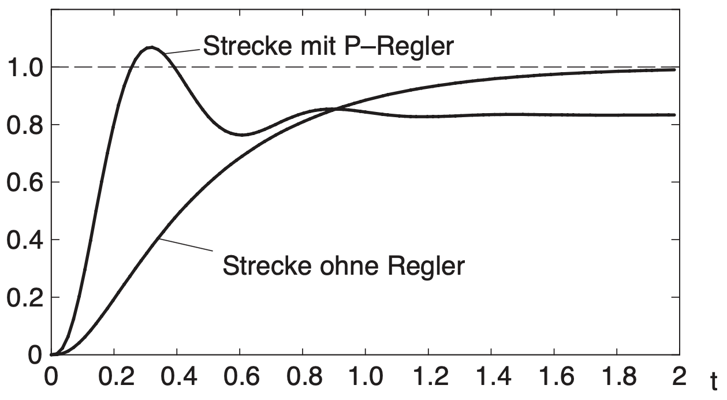
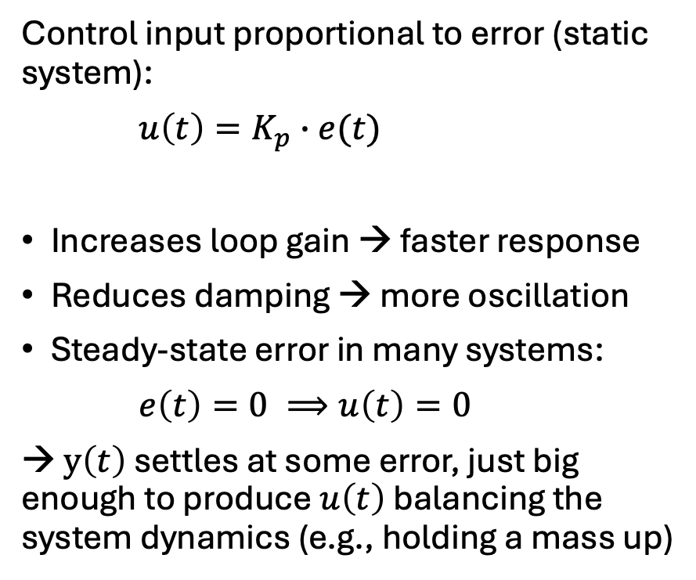
Proportional Control (P)
overshoot
Control input proportional to error (static system):
$u\left(t\right)=K_{p}∙e(t)$
Increases loop gain → faster response
Reduces damping → more oscillation
Steady-state error in many systems:
$e\left(t\right)=0 ⟹u\left(t\right)=0$
→ $y\left(t\right)$ settles at some error, just big enough to produce $u\left(t\right)$ balancing the system dynamics (e.g., holding a mass up)
with P controller
without controller

Slide 11
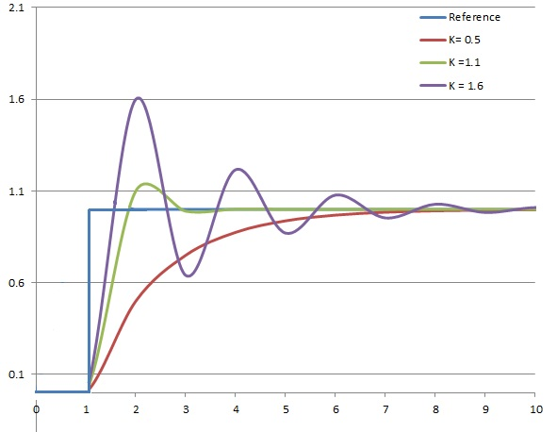
Effect of Proportional Gain Parameter

Slide 12
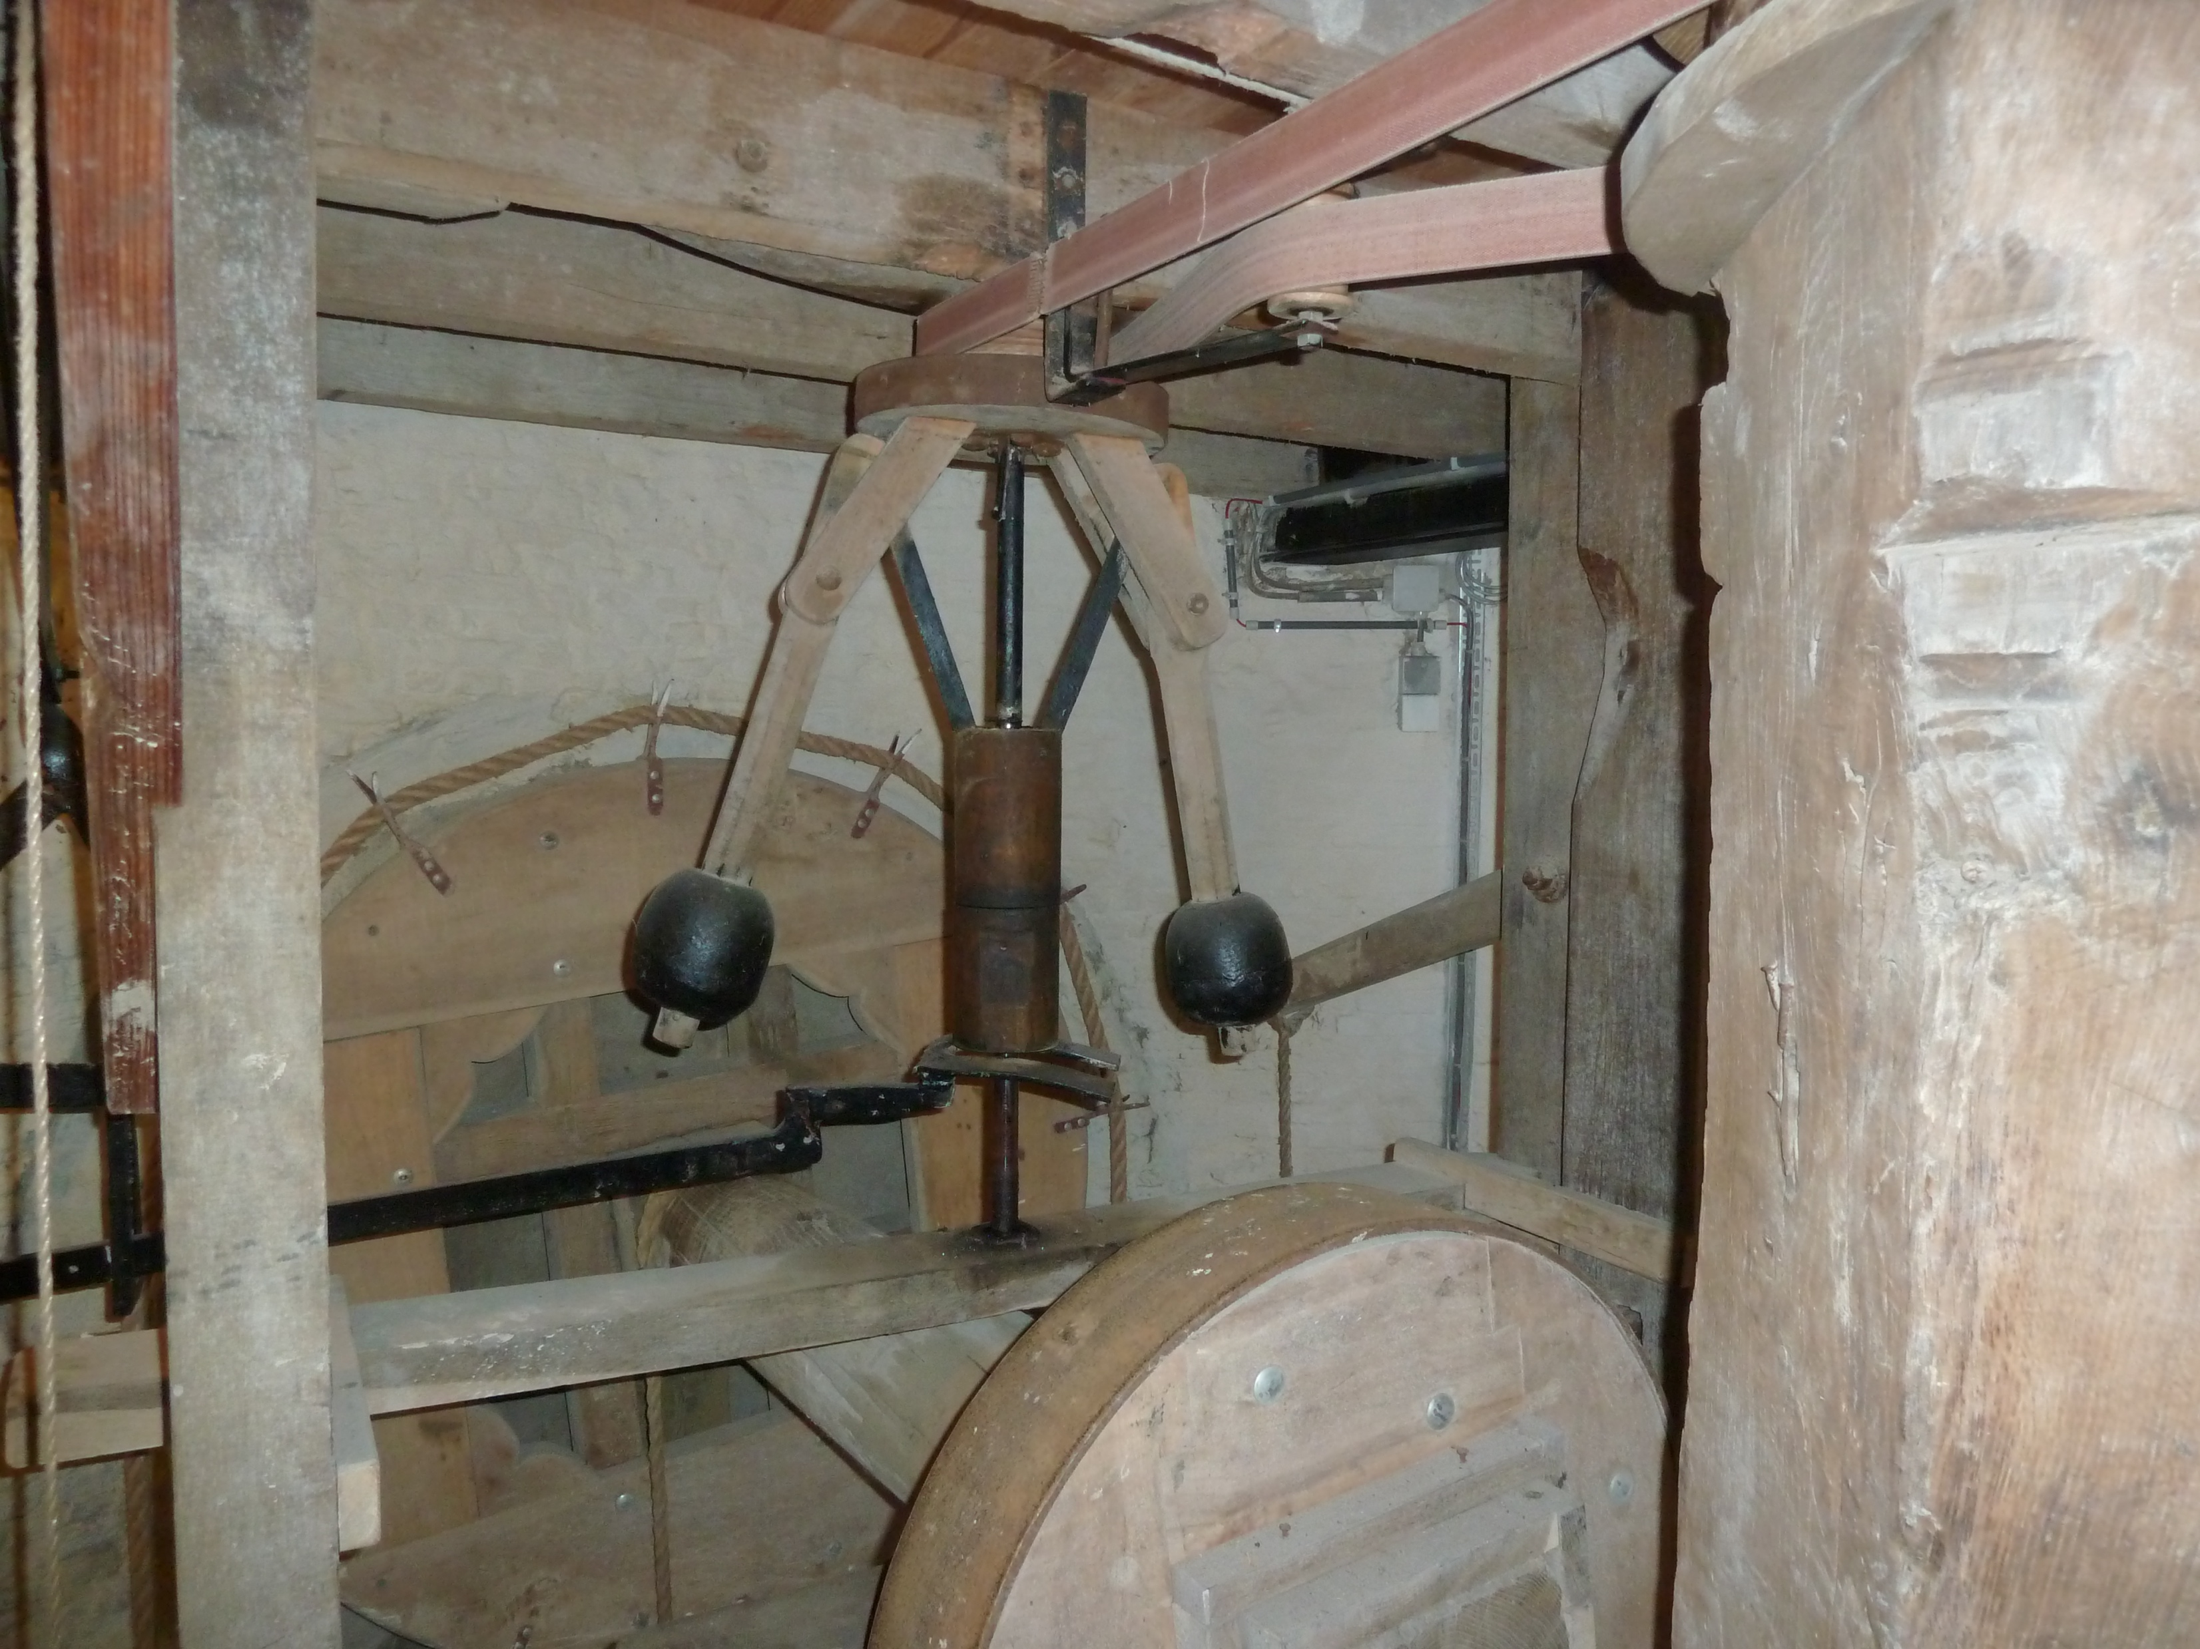
Historical: Centrifugal Governor in a Windmill
Working principle:
wind turns the blades
→ blades turn a shaft (plant)
→ shaft spins a pair of weighted arms (controller)
→ arms mechanically twist the blades (actuator)
Automatic regulation:
faster rotation (controlled variable: angular speed)
→ centrifugal force pushes weights outward (error: deviation from position at reference angular speed)
→ blades are twisted to catch less wind (proportional control) → slower rotation
Steady-state error: need for twisted blades to balance torque from wind and load → speed offset

Slide 13
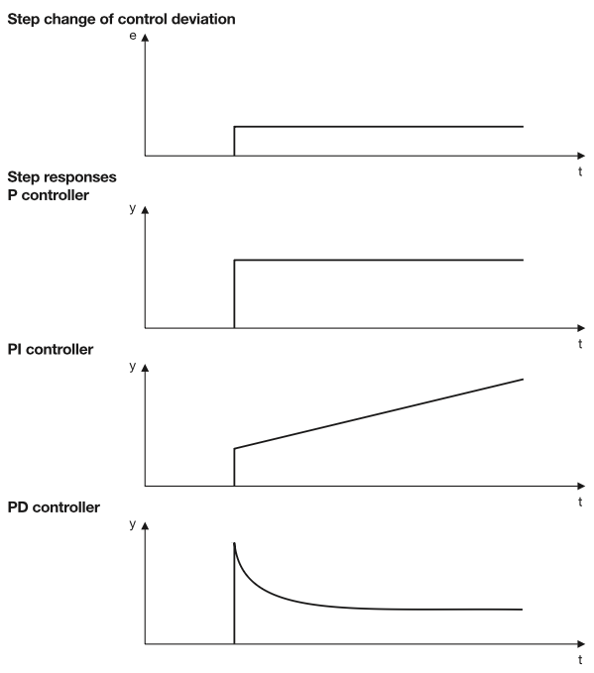
Integral Control (I)
Integrator accumulating past error (dynamic)
Eliminates steady-state error to step inputs
Slower response
Reduces damping → more oscillation
Order of total system increases
PT1 → second order
PT2 → third order

Slide 14
Derivative Control (D)
Derivative predicting future error based on the rate of change (dynamic)
Predictive action
Increases effective damping (keeps system near critical damping): less overshoot, fewer oscillations)
Derivative action amplifies high-frequency noise → often paired with a low-pass filter
Used less often in practice due to impact on system stability → PI

Slide 15
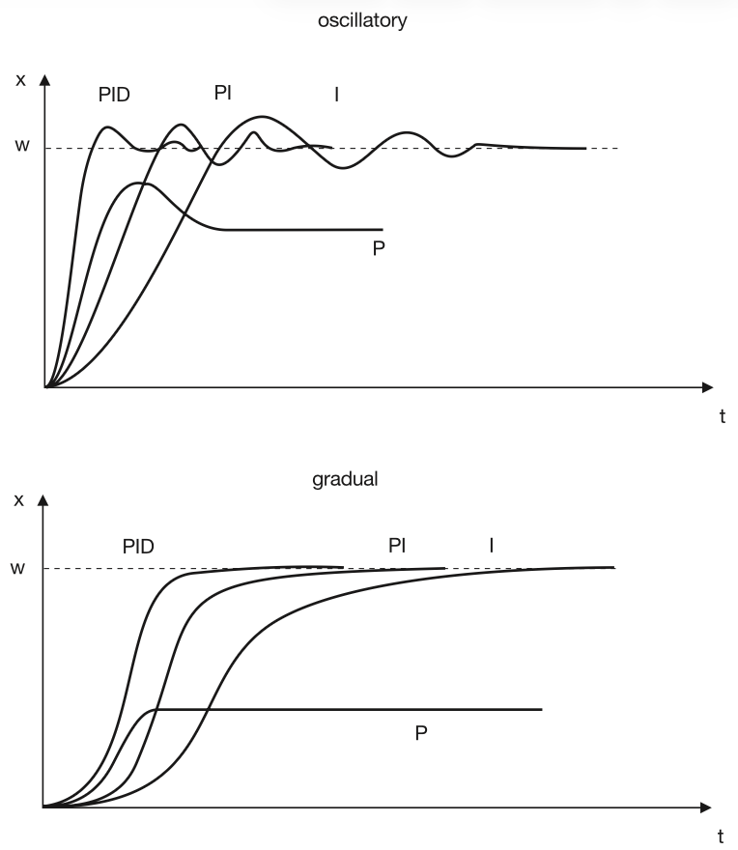
PID Controller
Simple and intuitive
Works for many plants
Easy to tune experimentally
No model of process needed
→ ~90% of industrial controllers are PID variants
P = speed
I = accuracy
D = damping

Slide 16
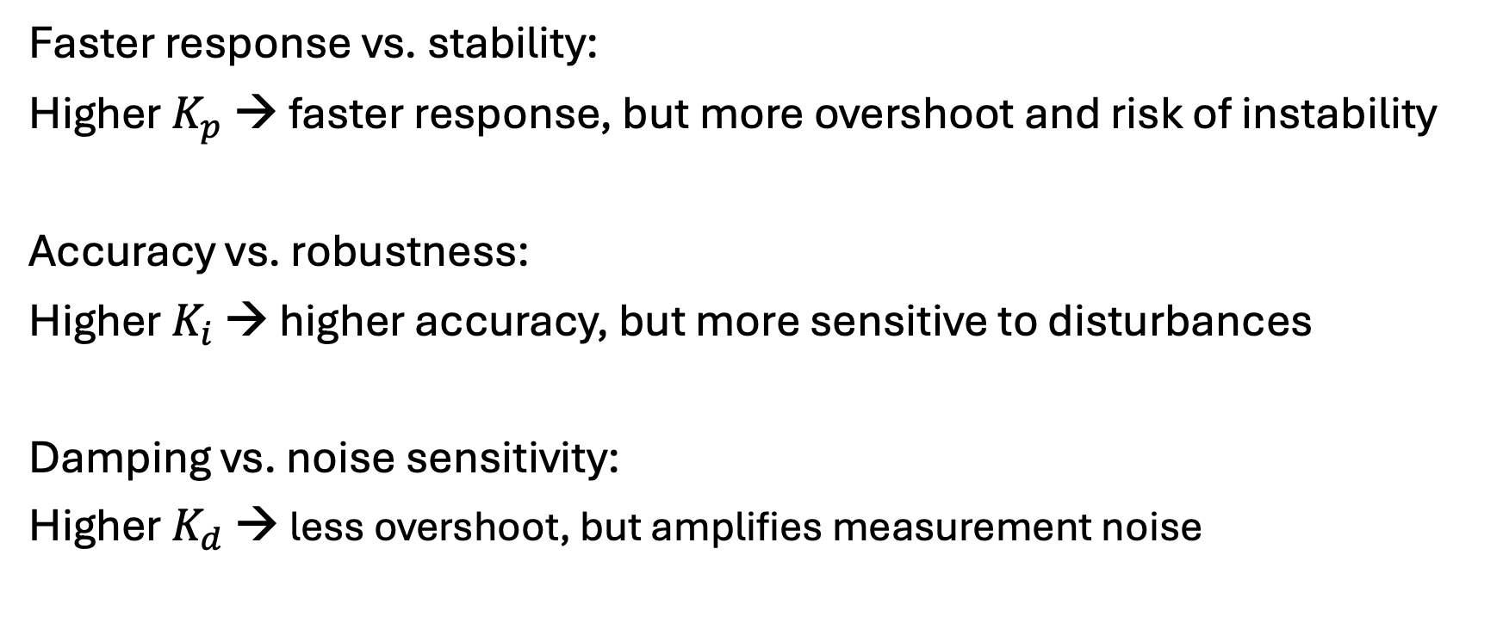
Time-Domain Performance Trade-Offs
Faster response vs. stability:
Higher $K_{p}$ → faster response, but more overshoot and risk of instability
Accuracy vs. robustness:
Higher $K_{i}$ → higher accuracy, but more sensitive to disturbances
Damping vs. noise sensitivity:
Higher $K_{d}$ → less overshoot, but amplifies measurement noise

Slide 17
Animated GIF

Slide 18
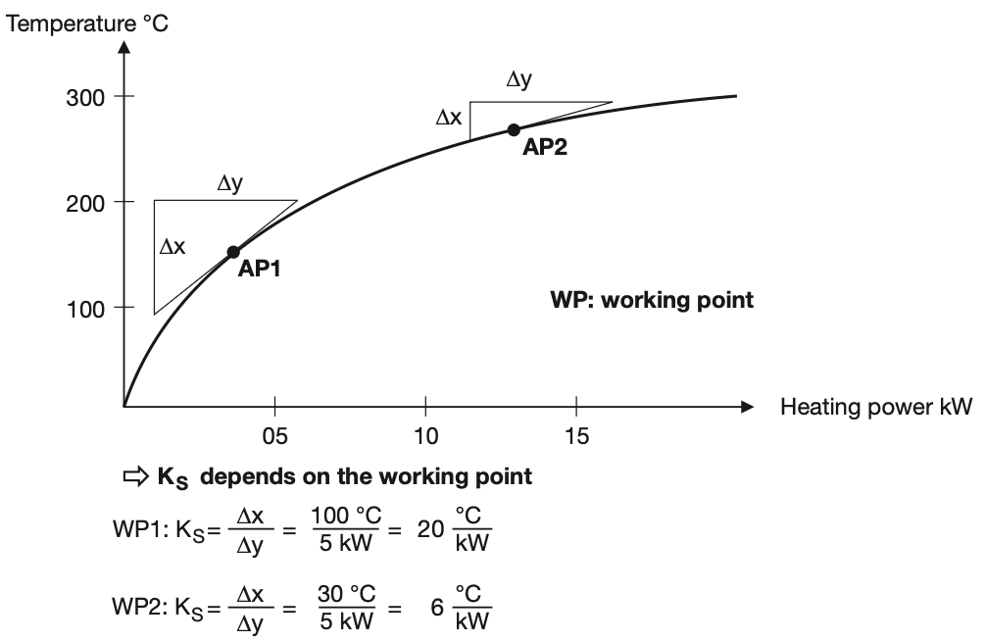
Working Point and Linearization
Controllers designed and tuned around the operating/working point of the system
Linear approximation of nonlinear systems
Valid locally
Example: furnace
W
W

Slide 19
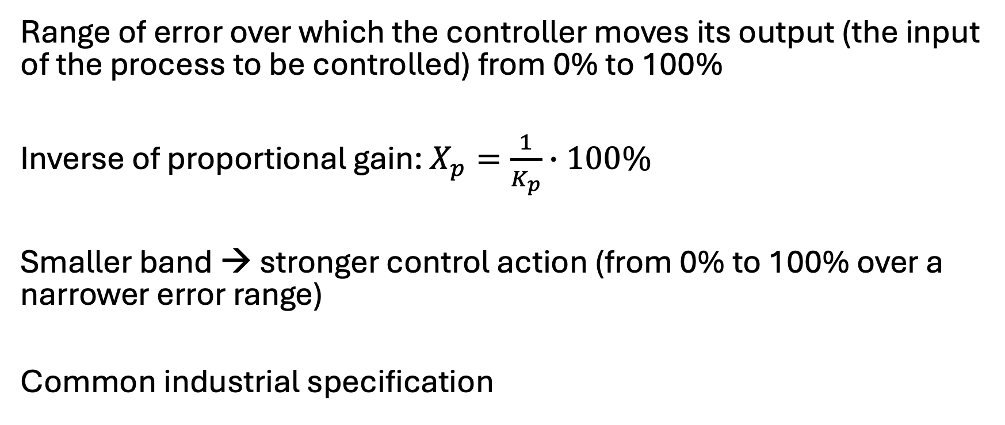
Proportional Band
Range of error over which the controller moves its output (the input of the process to be controlled) from 0% to 100%
Inverse of proportional gain: $X_{p}=\frac{1}{K_{p}}∙100\%$
Smaller band → stronger control action (from 0% to 100% over a narrower error range)
Common industrial specification

